Slide 1
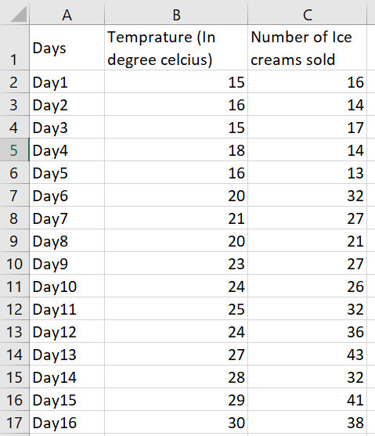
Case Study
We have Ice cream sales data of last 30 days and we want to predict the sales on the basis of temperature.
Create a Simple Linear Regression to predict the sales and also visualize the same using scatter plot chart.
Evaluate your model using R² score.

